Slide 1
Computer Engineering
Generated for: Operating Systems Basics, Introduction to Operating Systems, Process Management Concepts, Memory Management Techniques
Notes:
Welcome to the Computer Engineering presentation covering multiple topics. Today we'll explore: Operating Systems Basics, Introduction to Operating Systems, Process Management Concepts, Memory Management Techniques.

Slide 2
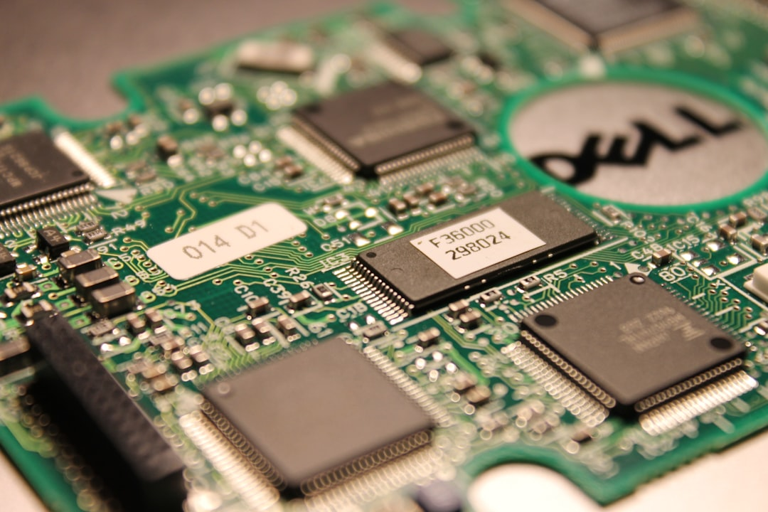
Introduction to Operating System Fundamentals
Manages computer hardware and software resources efficiently always
Provides a platform for running application software programs
Controls input output and storage devices operations
Handles file system and data storage management tasks
Supports multitasking and multithreading capabilities
Ensures system security and access control mechanisms
Manages memory and CPU allocation effectively always
Provides a user interface for interaction and feedback
Supports networking and communication protocols
Notes:
In this section, we will cover the basics of operating systems, including their primary functions and key characteristics. The operating system acts as an intermediary between computer hardware and user-level applications. We will explore how it manages resources, provides a platform for applications, and supports various system functions.

Slide 3
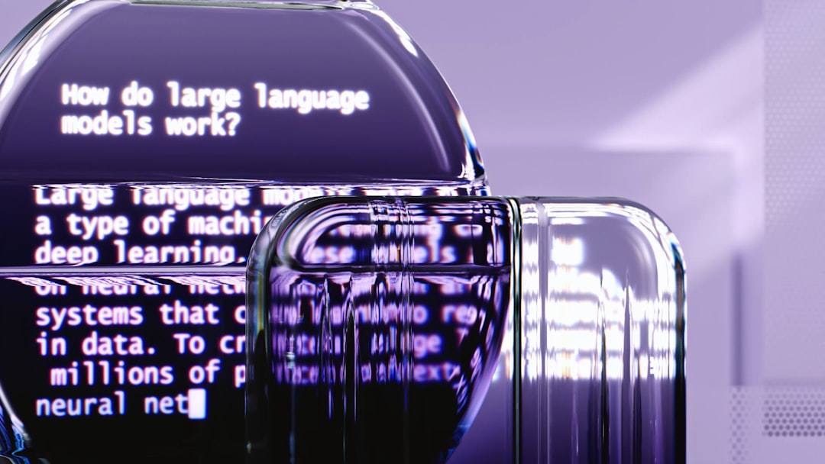
Part 2: Introduction to Operating System Fundamentals
Manages computer hardware and software resources efficiently always
Provides platform for running applications and services smoothly
Controls input output and storage devices effectively always
Manages memory and storage for optimal performance always
Handles user interface and experience intuitively always
Provides security and authentication mechanisms strongly
Supports multitasking and multithreading capabilities always
Manages file systems and directories effectively always
Optimizes system performance and responsiveness always
Notes:
In this section, we will cover the basics of operating systems, including their primary functions and key characteristics. Operating systems play a crucial role in managing computer hardware and software resources. We will explore how operating systems provide a platform for running applications and services, and how they manage memory, storage, and user interface.

Slide 4
Part 3: Introduction to Operating Systems Fundamentals
Manages computer hardware and software resources efficiently always
Provides a platform for running applications and services smoothly
Controls input output and storage devices effectively always
Ensures security and authentication for user data and access
Optimizes system performance and responsiveness always
Supports multitasking and multithreading capabilities fully
Manages memory and storage allocation dynamically always
Provides a user interface for interaction and navigation easily
Handles errors and exceptions gracefully always
Notes:
In this section, we will explore the basics of operating systems, including their primary functions and key characteristics. Operating systems play a crucial role in managing computer resources and providing a platform for running applications. We will discuss the different types of operating systems and their features in subsequent sections.

